Slide 1

Predicting Protein Function
Kaggle Competition

Slide 2
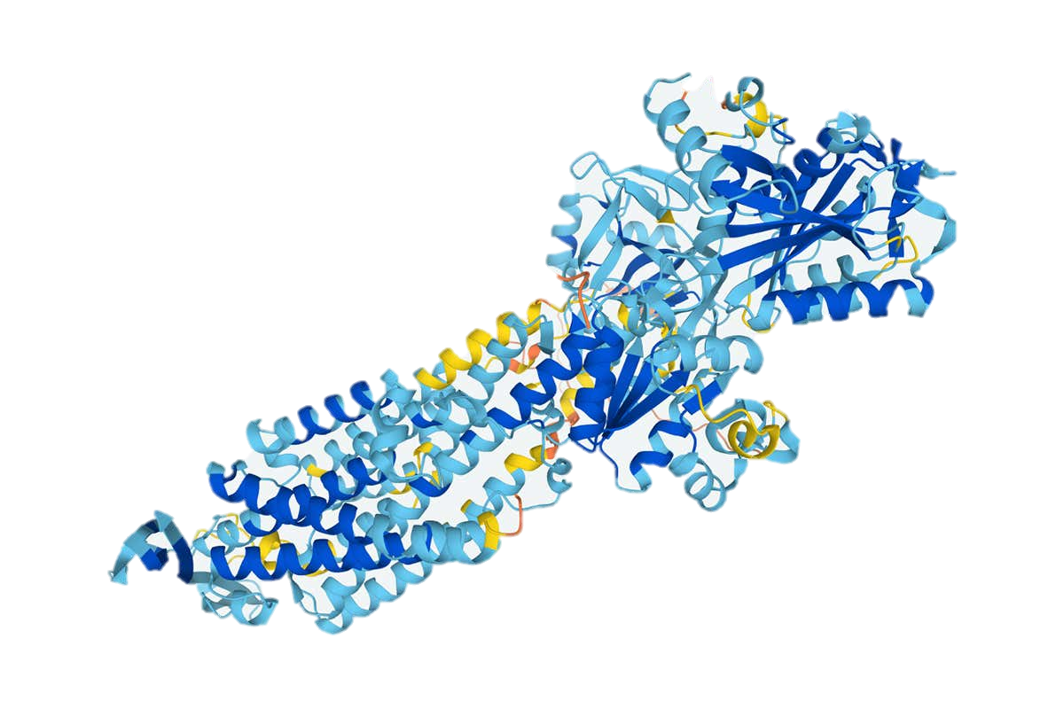
Introduction
The human body makes tens of thousands of different proteins
Each protein is composed of dozens or hundreds of amino acids that are linked sequentially
This amino-acid sequence determines the 3D structure and conformational dynamics of the protein, and that, in turn, determines its biological function.

Slide 3
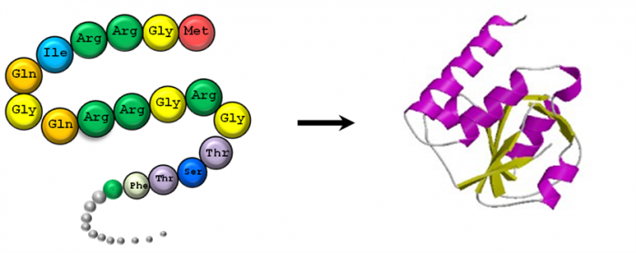
Introduction
Each protein is composed of dozens or hundreds of amino acids that are linked sequentially.
Each amino acid in the sequence may be represented by a one-letter or three-letter code. Thus the sequence of a protein is often notated as a string of letters.

Slide 4
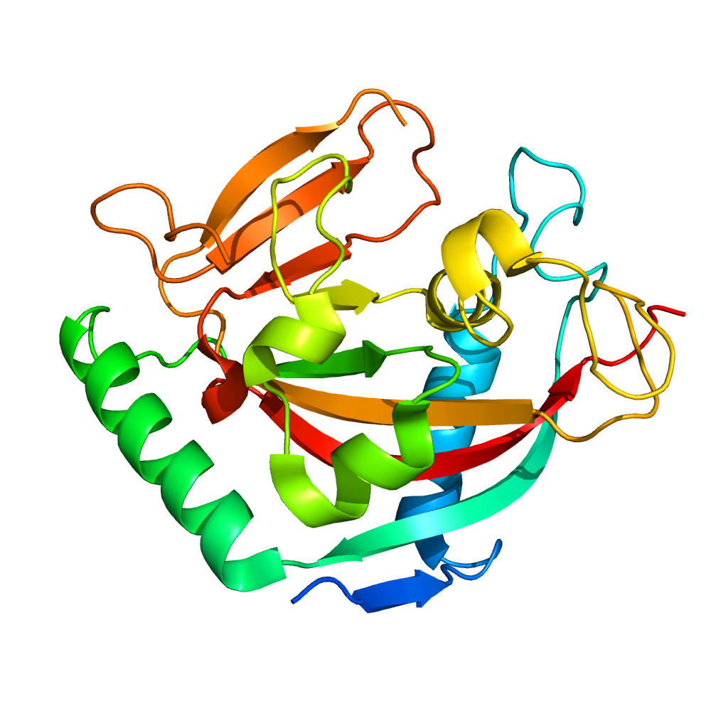
Problem Statement
Due to ongoing genome sequencing projects, we are inundated with large amounts of genomic sequence data from thousands of species, which informs us of the amino-acid sequence data of proteins for which these genes code.
The accurate assignment of biological function to the protein is key to understanding life at the molecular level.
More knowledge of the functions assigned to proteins—potentially aided by data science—could lead to curing diseases and improving human and animal health and wellness in areas as varied as medicine and agriculture.

Slide 5
Challenges
Assigning function to any specific protein can be made difficult due to
the multiple functions many proteins have
their ability to interact with multiple partners.

Slide 6
Dataset
The organizers provide a set of protein sequences on which the participants are asked to predict Gene Ontology (GO) terms in each of the three subontologies:
Molecular Function (MF)
Biological Process (BP)
Cellular Component (CC)
Submissions will be evaluated on proteins (test set) that did not have experimentally determined functional annotations in at least one subontology of the Gene Ontology (GO) before the submission deadline and have accumulated experimentally-validated functional annotations in that subontology between the submission deadline and the time of evaluation.

Slide 7
Evaluation
The maximum F-measure based on the weighted precision and recall will be calculated on each of the three test sets and the final performance measure will be an arithmetic mean of the three maximum F-measures (for MF, BP, and CC).

Slide 8

Gene Ontology

Slide 9
Gene Ontology
Gene Ontology (GO) is a widely used bioinformatics resource that provides a structured and standardized vocabulary for describing gene and protein attributes in a hierarchical manner.
A common language to describe gene functions, processes, and cellular components across different organisms. It consists of three main branches or ontologies:
Molecular Function: This branch describes the elemental activities or tasks performed by individual gene products, such as binding to specific molecules or catalyzing chemical reactions.
Biological Process: This branch describes larger biological events, pathways, or processes that involve multiple gene products working together. It includes processes such as cell cycle, signal transduction, and immune response.
Cellular Component: This branch describes the locations or structures within a cell where gene products are active, such as the nucleus, mitochondria, or cytoplasm.

Slide 10
Gene Ontology
Each branch of the Gene Ontology is organized as a directed acyclic graph (DAG)
By annotating genes with GO terms, researchers can gain insights into the functions, processes, and cellular locations associated with specific genes.
This information can be used for functional enrichment analysis, comparing gene sets, pathway analysis, and interpreting large-scale genomic and proteomic data.

Slide 11
Gene Ontology
GO is a directed acyclic graph.
The nodes in this graph are functional descriptors (terms or classes) connected by relational ties between them (is_a, part_of, etc.).
For example, terms 'protein binding activity' and 'binding activity' are related by an is_a relationship
This graph contains three subgraphs (subontologies): Molecular Function (MF), Biological Process (BP), and Cellular Component (CC), defined by their root nodes.
what it does on a molecular level (MF), which biological processes it participates in (BP) and where in the cell it is located (CC).

Slide 12
Gene Ontology
These annotations are supported by evidence codes
experimental (e.g., as documented in a paper published by a research team of biologists)
non-experimental. Non-experimental terms are usually inferred by computational means.

